Slide 1

Water Quality Analysis
Welcome to the world of water quality analysis. Join me on a journey to explore the importance of monitoring and understanding the quality of our water resources.

Slide 2

Importance of Water Quality Analysis
1
Protect Human Health
Regular analysis ensures that water sources are safe for drinking, bathing, and other everyday uses.
2
Safeguard the Environment
By monitoring water quality, we can identify and rectify issues that impact aquatic ecosystems and biodiversity.
3
Support Sustainable Development
Understanding water quality helps us make informed decisions about resource management and sustainable planning.

Slide 3
Methods for Water Quality Analysis
Field Testing
Laboratory Analysis
Remote Sensing
Quick and portable tests performed on-site to assess key parameters like pH, temperature, and turbidity.
Utilizing satellite imagery and other remote sensing technologies to monitor large water bodies from afar.
More comprehensive tests conducted in controlled laboratory settings to measure a wide range of chemical and biological components.

Slide 4

Parameters Measured in Water Quality Analysis
Physical Parameters
Chemical Parameters
Biological Parameters
Temperature, turbidity, conductivity, and dissolved oxygen levels help identify changes and assess water suitability.
pH, nitrates, phosphates, heavy metals, and pesticide presence reveal potential contamination and pollution sources.
Microbial content, algae blooms, aquatic species health, and biodiversity inform about water ecosystem vitality.

Slide 5
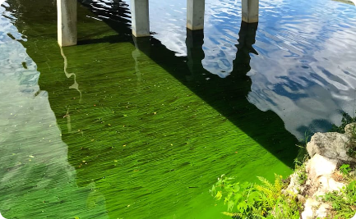
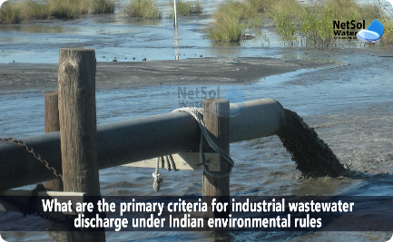
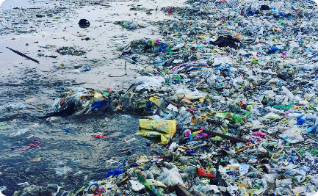
Common Water Quality Issues
Algae Blooms
Industrial Discharges
Plastic Pollution
Excessive nutrient levels can cause harmful algal blooms, threatening aquatic life and water supply systems.
Improper disposal of industrial waste can introduce pollutants into water bodies, impacting ecosystems and quality.
Plastic waste in oceans and rivers poses environmental hazards and harms aquatic organisms through ingestion and entanglement.

Slide 6
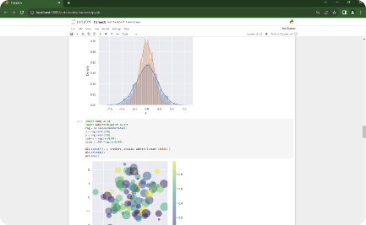
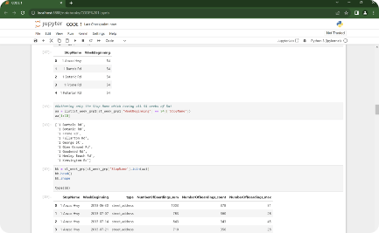
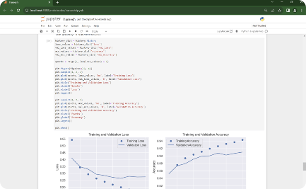
Why Jupyter Notebook ?
Visualizing Data in Jupyter Notebook
Executing Code in Jupyter Notebook
Machine Learning Algorithms in Jupyter Notebook
Demonstrating the power of data visualization using Jupyter Notebook's interactive capabilities.
Witness the step-by-step execution of code snippets within the Jupyter Notebook environment.
Showcasing the implementation of KNN, CNN, and Gradient Descent algorithms in Jupyter Notebook.

Slide 7
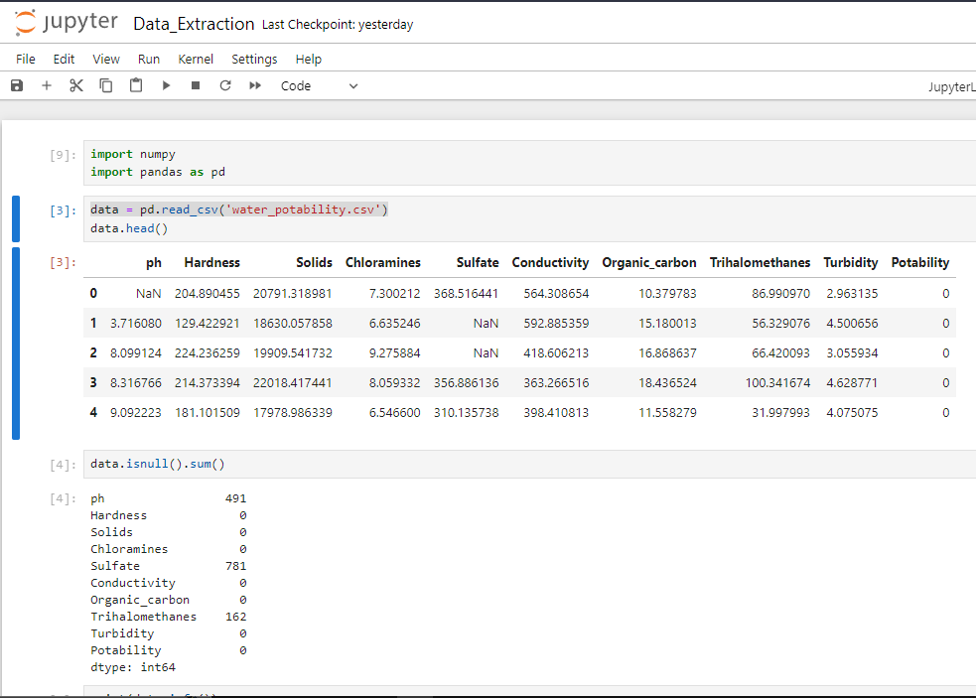
Data Extraction With Jupyter Notebook
Jupyter Notebook is widely used to extract data and to work with datasets due to its high flexibility and user-friendly interface. For this project, we utilized Jupyter Notebook to extract data from CSV files. Specifically, we extracted data from dataset provided by the Kaggle ‘water_potability.csv’. By leveraging Pandas, a popular library of Python, we were able to efficiently extract and manipulate the data.

Slide 8
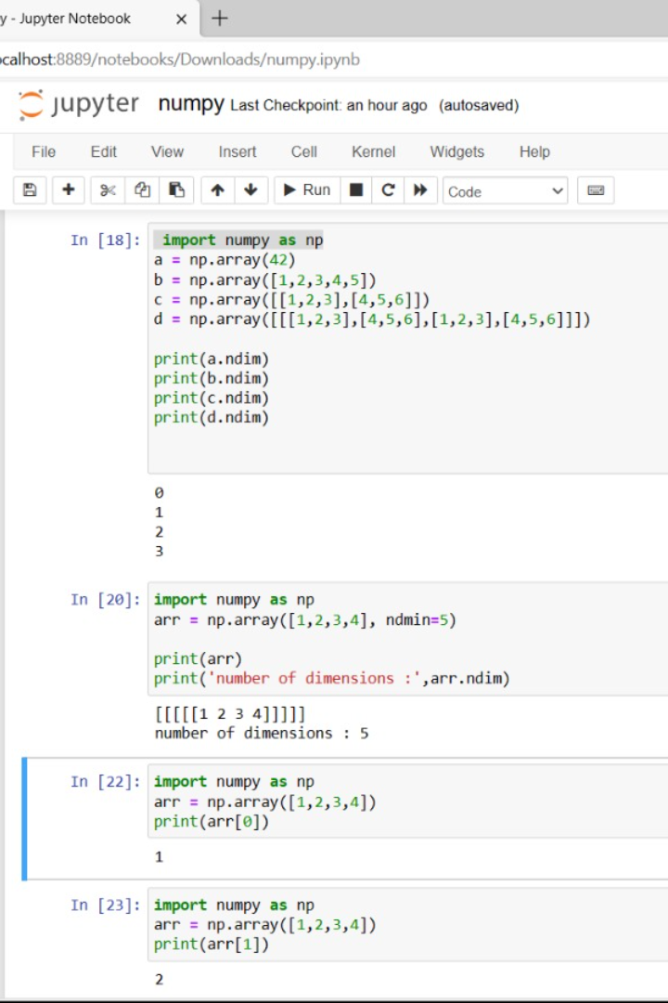
Why Jupyter Notebook ?
NumPy
Data Loading: NumPy aids in reading and handling datasets from various file formats.
Data Preparation: It assists in cleaning, normalizing, and converting data types.
Visualizing Data in Jupyter Notebook
Executing Code in Jupyter Notebook
Machine Learning Algorithms in Jupyter Notebook
Data Exploration: NumPy calculates statistics, revealing insights into transportation data.
Demonstrating the power of data visualization using Jupyter Notebook's interactive capabilities.
Witness the step-by-step execution of code snippets within the Jupyter Notebook environment.
Numerical Operations: Efficient element-wise operations, aggregations, and calculations are easily performed. The above operations are processed in the adjacent screenshot.
Showcasing the implementation of KNN, CNN, and Gradient Descent algorithms in Jupyter Notebook.

Slide 9
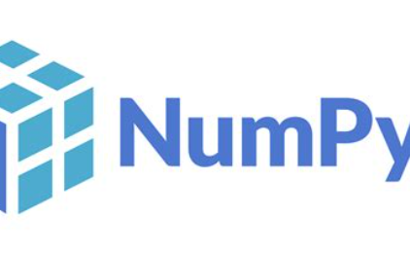


Introduction
NumPy
Pandas DataFrame
Matplotlib
NumPy, which stands for "Numerical Python," provides support for working with large, multi-dimensional arrays and matrices, along with a collection of mathematical functions to operate on these arrays efficiently. NumPy is a core library in the Python data.
A pandas DataFrame is a two-dimensional, labelled data structure commonly used in data analysis and manipulation within the Python programming language. It is one of the fundamental data structures provided by the pandas library.
Matplotlib is a widely-used Python library for creating static and interactive visualizations and plots. It is a powerful tool for data visualization and is particularly popular in the fields of data analysis, scientific computing, and machine learning.

Slide 10
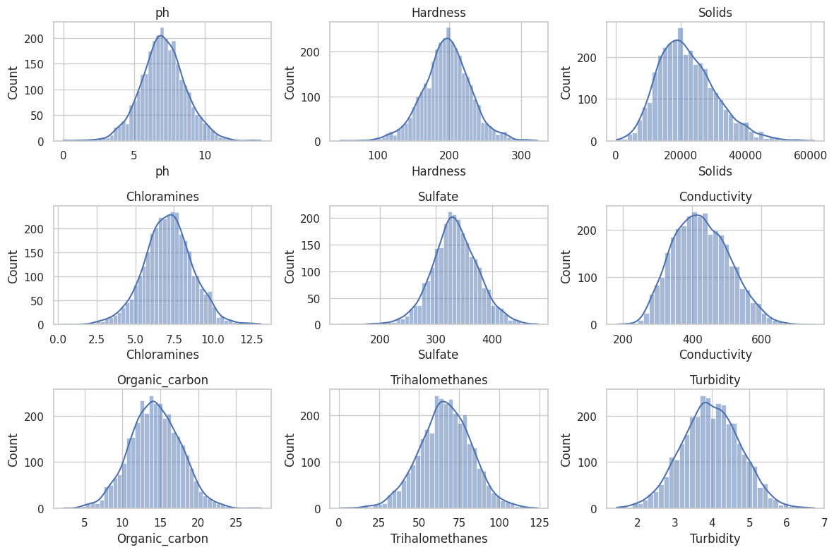
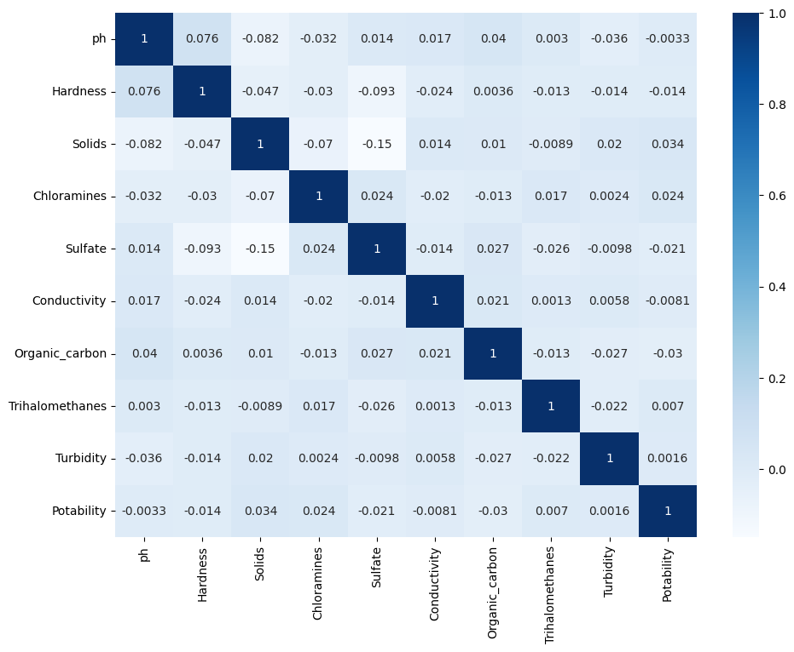
White Grid :
Heatmap :
Why Jupyter Notebook ?
Visualizing Data in Jupyter Notebook
Executing Code in Jupyter Notebook
Machine Learning Algorithms in Jupyter Notebook
Demonstrating the power of data visualization using Jupyter Notebook's interactive capabilities.
Witness the step-by-step execution of code snippets within the Jupyter Notebook environment.
Showcasing the implementation of KNN, CNN, and Gradient Descent algorithms in Jupyter Notebook.

Slide 11

Impacts of Poor Water Quality
1
Health Risks
Poor water quality can lead to waterborne diseases, including gastrointestinal illnesses and infections.
2
Threatened Ecosystems
Habitat degradation, loss of biodiversity, and disruption of delicate ecosystems are consequences of pollution.
3
Economic Consequences
Costly treatments, impacts on tourism, and compromised agricultural productivity result from polluted water sources.

Slide 12
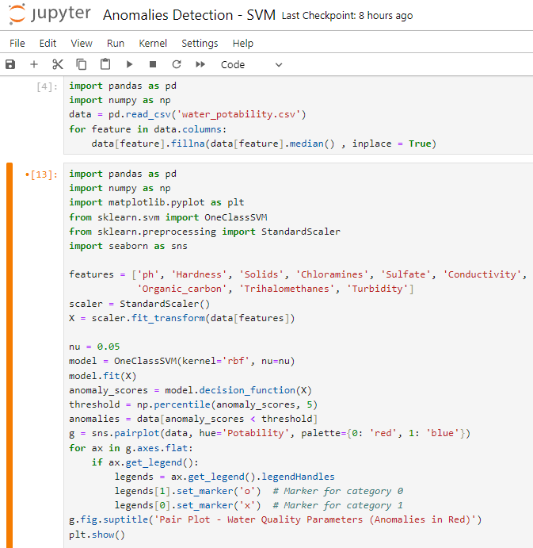
One Class – Support Vector Machine
A One-Class Support Vector Machine (One-Class SVM) is a machine learning algorithm used for novelty detection and anomaly detection. It is particularly useful when you have a dataset with only one class of examples (i.e., mostly normal data) and you want to identify rare anomalies or outliers within that class. One-Class SVM is a powerful algorithm for identifying anomalies or outliers in datasets where one class dominates, making it valuable for various anomaly detection tasks.

Slide 13

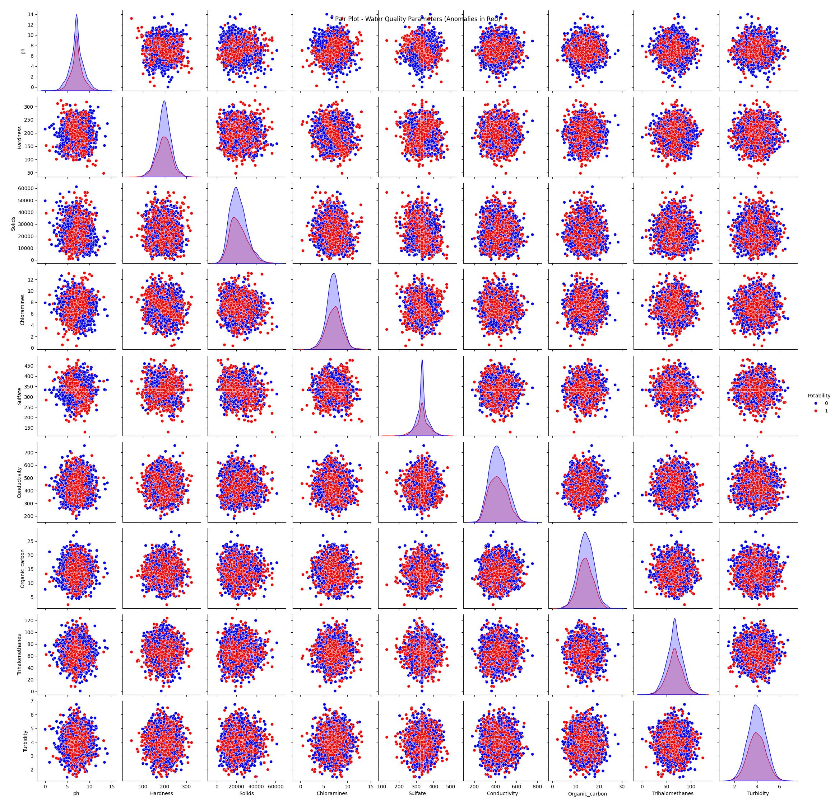
Output
In anomaly detection, we would normally identify anomalies (unusual patterns) within the "Non-Potable" or "0" class, as these are the cases where water quality issues or problems are typically found. "Potable" or "1" class represents the majority of data points and is considered normal.
Interpretation:
0 (Red): This class typically represents the class of data points that are labeled as "Non-Potable" or "Unsafe." These are water quality samples that are considered unsafe or not suitable for consumption or use.
1 (Blue): This class typically represents the class of data points that are labeled as "Potable" or "Safe for Consumption." These are water quality samples that are considered safe and suitable for consumption or use.

Slide 14
Proposed Solution
PARAMETER | DESCRIPTION
Problem Statement (Problem to be solved) | Water quality prediction using machine learning techniques. Our model predicts the drinkability of the water based parameters such as pH, Conductivity, and hardness of the water.
Idea / Solution Description | Water quality prediction model using the principal component analysis followed by decision tree classification. Firstly, the water quality index (WQI) is calculated using the weighted arithmetic index method. Secondly, the principal component analysis (PCA) is applied to the dataset, and the most dominant WQI parameters have been extracted. Thirdly, to predict the WQI, different regression algorithms are used to the PCA output. Finally, the decision tree classifier model is utilized to classify the Water quality status.

Slide 15

Conclusion and Recommendations
Enhance water quality monitoring programs
Promote sustainable agricultural practices
Encourage responsible industrial waste management
Support community education and awareness initiatives

